Slide 1
ENSE 374, Milestone 2
Snow Bird
Ali Rizvi, Raymond Knorr,
Sana Khan, Zain Abedin,
Priscilla Chua, Li Pan
2018-10-11

Slide 2
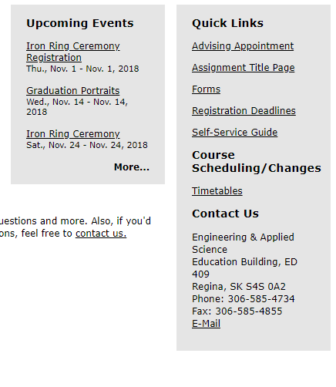
Engineering Homepage
Changes in navigation styles of quick links and upcoming event will improve the design of homepage and give more organized impression
Text alignment should be done properly
Contains some repeating information ( e.g. Contact us information)
Some of the navigations have broken links (e.g.News & Events)
Some navigations contain unrelated and detailed content that user might not find interesting and helpful

Slide 3
Engineering Homepage
Content provided on homepage can be reduced and written into the related section (Faculty News should go in News & Events)
REMOVAL:
Upcoming Events should be removed and placed into News and Event section.
Iron Ring Ceremony sections should be combined into one section and should be removed from upcoming events since a navigation is already provided on left.
Registration deadline link is broken and does not work. It should be either fixed or removed
Some downloadable files are not supported for download. They should be fixed.

Slide 4
Faculty and Staff
Uses massive list of faculty members on virtually every page
Would benefit from restructuring, as it is very unwieldy at the moment
“Engineering General” page seems to be just a formality. Not of any real use to public.
For the most part, it has a shallow file structure and nothing is hard to find, although it would still benefit from search functionality

Slide 5
Faculty and Staff Content Removal
These pages are comprised of lists of faculty and staff members
No content that would need removal from the public page, except possibly “Engineering General”

Slide 6
Students
Main improvement points:
Combining some site pages into one page
Some content pages could be removed
Student Resources can include some additional files:
Student Groups & Events
Student Safety Training

Slide 7
Students
Consider putting all of the forms throughout the Forms page in one master page, separated by user instead of subject
Users should be able to see all relevant forms within the same page
Forms and Event Registration Forms

Slide 8
Students Content Removal
Large portions of the Forms subsection like “Office, Laboratory & Key Card Access Forms & Requirements”, and “Safety & Travel-Related Forms” should be moved to a private faculty page, or at least somewhere off of the Students page
In After Convocation, Engineer-in-Training can be removed, as it is already included on another page
Scholarships page is duplicated in Student Resources

Slide 9
Programs
This portion is fairly organized. Each of the programs has its own page where you can find information
There is easy access to quick links such as admission and registration, forms, timetables and co-operative education.
Even though the site is organized, there is still room for some improvement. One thing that could be improved is graduate program should have its own section rather than being with the same undergraduate programs as this might lead to some confusion.

Slide 10
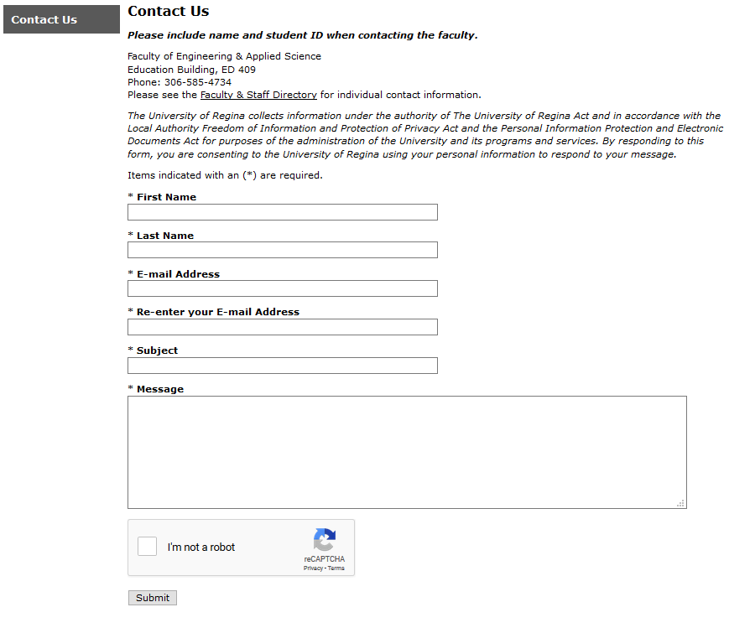
Contact Us
Good:
Anyone who is seeing this page for the first time should be able to successfully submit a form on their own.
The entire form can be filled out on one page without having to interact with multiple pages or objects.
There is very little room for error when filling out the form.

Slide 11
Contact Us
Possible Improvements:
There is a lot of whitespace on the page which could potentially be used for something more meaningful.
More reusability so that the form can be used to contact individual faculty/staff members.

Slide 12
Group reflection
How did you feel about this milestone? What did you like about it? What did you dislike?
More clear about project requirement, planning ahead (time tight)
What did you learn about yourself as you collaborated and worked through this milestone?
That we should pay more attention to details, stick to project schedule
How will you use what you have learned going forward?
Review project requirements continuously, keep tracking the process
What “stuff & things” related to this milestone would you want help with?
Brainstorm everything that needs to be done, dynamic plans, more in depth

